Slide 1
5.4 Fundamental Theorems of Asset Pricing (2)
劉彥君

Slide 2
When there is no solution to the market price of risk equations, the arbitrage in the model may not be obvious as in Example 5.4.4, but it does exist.
If there is a solution to the market price of risk equations, then there is no arbitrage.

Slide 3
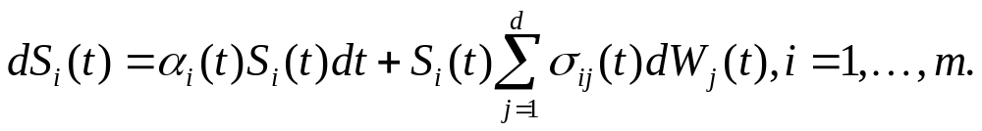
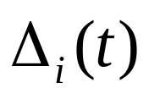
Notation
  In the market with stock price S_{i}(t) given by
  interest rate process R(t),
  initial capital X(0)
  Choose adapted portfolio process , one for each stock S_{i}(t)
(5.4.6)

Slide 4
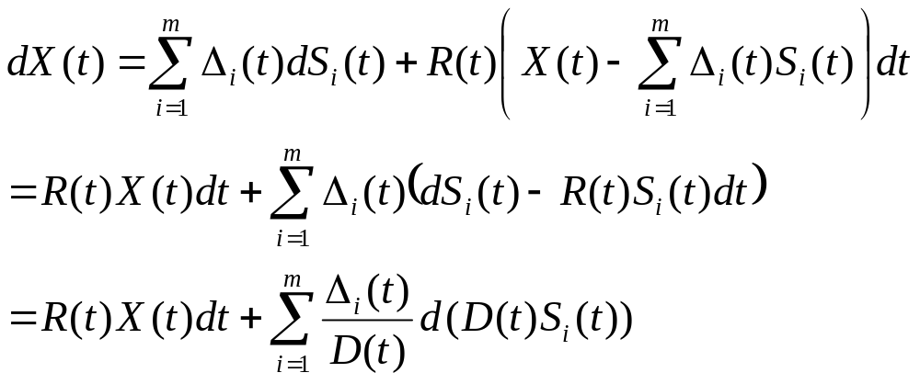
The differential of the agent’s portfolio value will then be
(5.4.21)

Slide 5
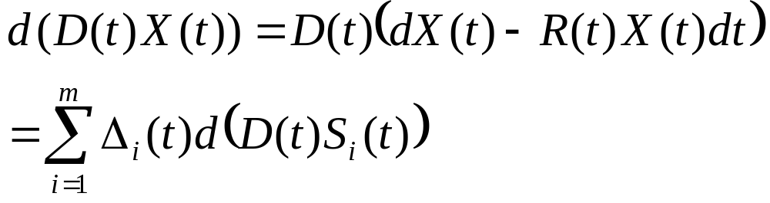
The differential of the discounted portfolio value is
(5.4.22)

Slide 6

If is a risk-neutral measure, then under
the processes D(t)S_{i}(t) are martingales, and hence the process D(t)X(t) must also be a martingale.
Put another way, under each of the stocks has mean rate of return R(t), the same as the rate of return of the money market account.

Slide 7
Hence, no matter how an agent invests, the mean rate of return of his portfolio value under must also be R(t), and the discounted portfolio value must then be a martingale.

Slide 8
Lemma 5.4.5
  Let be a risk-neutral measure, and let X(t) be the value of a portfolio. Under , the discounted portfolio value D(t)X(t) is a martingale.

Slide 9
Definition 5.4.6
  An arbitrage is a portfolio value process X(t) satisfying X(0)=0 and also satisfying for some time T>0
An arbitrage is a way of trading so that one starts with zero capital and at some later time T is sure not to have lost money and furthermore has a positive probability of having made money.
(5.4.23)

Slide 10
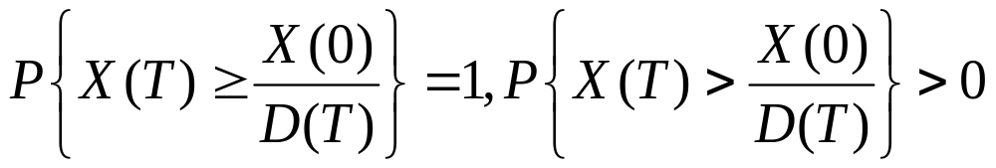
Such a opportunity exists if and only if there is a way to start with positive capital X(0) and to beat the money market account.
In other words, there exists an arbitrage if and only if there is a way to start with X(0) and at a later time T have a portfolio value satisfying
(see Exercise 5.7)
(5.4.24)

Slide 11

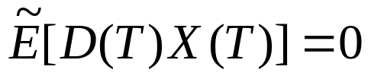
Theorem 5.4.7
(First fundamental theorem of asset pricing)
Theorem 5.4.7
  If a market model has a risk-neutral probability measure, then it does not admit arbitrage.
Proof
  If a market model has a risk-neutral probability measure , then every discounted portfolio value process is a martingale under .
  In particular, every portfolio value process satisfies
  Let X(t) be a portfolio value process with X(0)=0. Then we have

Slide 12

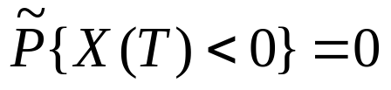


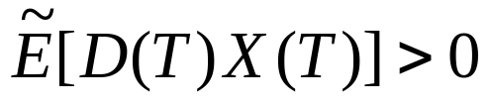
Theorem 5.4.7
(First fundamental theorem of asset pricing)
Proof (cont.)
  Support X(T) satisfies P{X(T) ≥ 0} = 1 (i.e., P{X(T) < 0} = 0)
  Since is equivalent to P, we have also
  .
  This, coupled with (5.4.25), implies
  , for otherwise we would have
  , which would imply .

Slide 13
Theorem 5.4.7
(First fundamental theorem of asset pricing)
Proof (cont.)
  Because P and are equivalent, we have also P{X(T) > 0} =0.
  Hence, X(t) is not an arbitrage.
  In fact, there cannot exist an arbitrage since every portfolio value process X(t) satisying X(0)=0 cannot be an arbitrage.

Slide 14
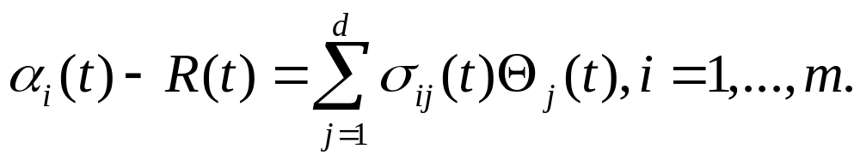
One should never offer prices derived from a model that admits arbitrage, and the First Fundamental Theorem provides a simple condition one can apply the check that the model one is using does not have this fatal flaw.
In our model with d Brownian motions and m stocks, this amounts to producing a solution to the market price of risk equations (5.4.18)
(5.4.18)

Slide 15
In models of the term structure of interest rates (i.e., models that provide prices for bonds of every maturity), there are many instruments available for trading, and possible arbitrages in the model prices are a real concern.
An application of the First Fundamental Theorem of Asset Pricing in such a model leads directly to the Heath-Jarrow-Morton condition for no arbitrage in term-structure models.

Slide 16


5.4.4 Uniqueness of the Risk-Neutral Measure
Definition 5.4.8.
  A market model is complete if every derivative security can be hedged.
Let us suppose we have a market model with
  a filtration generated by a d-dimensional Brownian motion
  A risk-neutral measure
    i.e., we have solved the market price of risk equations (5.4.18)
    Using the resulting market prices of risk Θ₁(t), … , Θ_{d}(t) to define the Radon-Nikodym derivative process Z(t), and have changed to the measure under which defined by (5.4.2) is a d-dimensional Brownian motion.

Slide 17
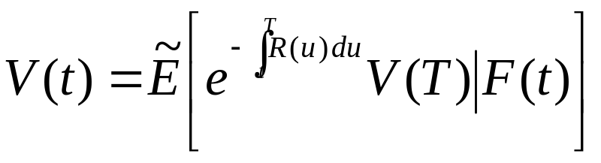
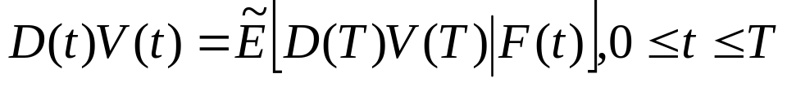
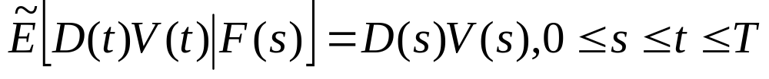
Suppose further that we are given an F(T)-measurable random variable V(T), which is the payoff of some derivative security.
We would like to be sure we can hedge a short position in the derivative security whose payoff at time T is V(T).
We can define V(t) by (5.2.31),
so that D(t)V(t) satisfies (5.2.30)
and just as in (5.3.3)

Slide 18

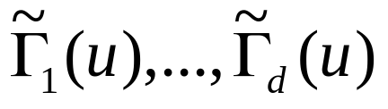
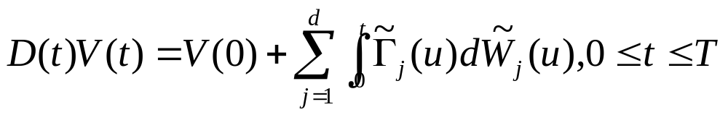
We see that D(t)V(t) is a martingale under
According to the Martingale Representation Theorem 5.4.2, there are processes such that
(5.4.26)

Slide 19
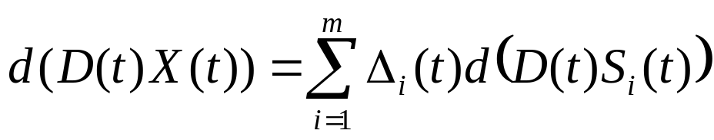
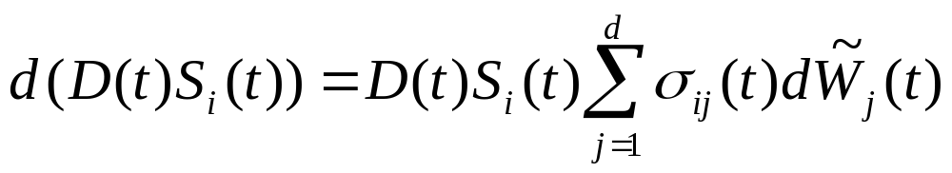
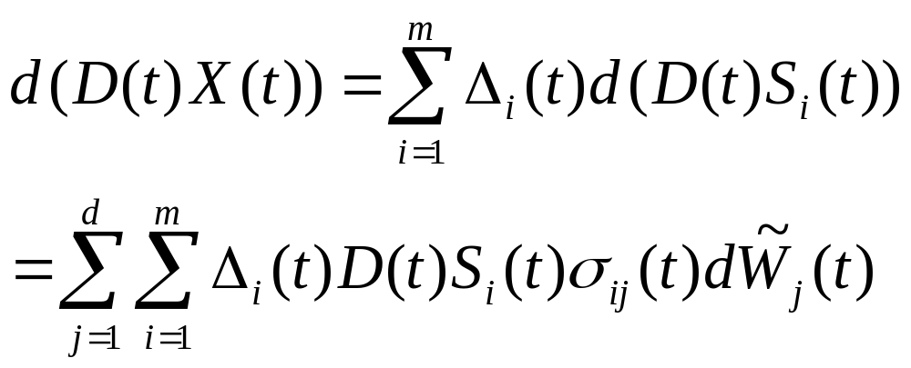
Consider a portfolio value process that begins at X(0). According to (5.4.22) and (5.4.17)
(5.4.22)
(5.4.17)
(5.4.27)

Slide 20
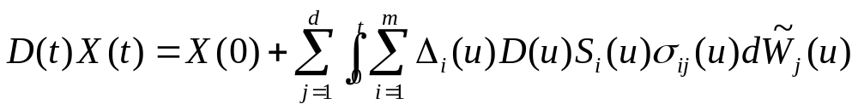
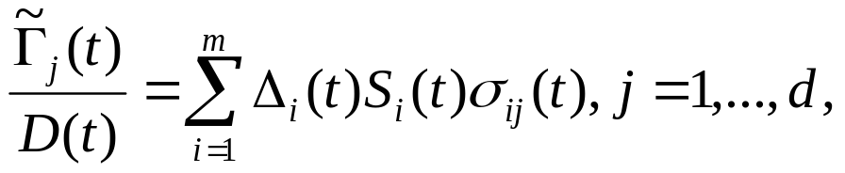
Or, equivalently,
Comparing (5.4.26) and (5.4.28), we see that to hedge the short position, we should take X(0)=V(0) and choose the portfolio processes Δ₁(t),…, Δ_{m}(t), so that the hedging equations
are satisfied. These are d equations in m unknown processes Δ₁(t),…, Δ_{m}(t).
(5.4.28)
(5.4.29)

Slide 21
Theorem 5.4.9
(Second fundamental theorem of asset pricing)
Theorem 5.4.9
  Consider a market model that has a risk-neutral probability measure. The model is complete if and only if the risk-neutral probability measure is unique.

Slide 22


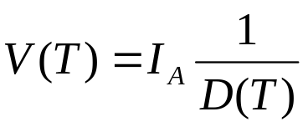
Theorem 5.4.9
(Second fundamental theorem of asset pricing)
Sketch of Proof
  First, assume that the model is complete.
  We wish to show that there can be only one risk-neutral measure.
  Suppose the model has two risk-neutral measures, and .
  Let A be a set in F, which we assumed at the beginning of this section is the same as F(T).
  Consider the derivative security with payoff

Slide 23

Theorem 5.4.9
(Second fundamental theorem of asset pricing)
Sketch of Proof (cont.)
  Because the model is complete, a short position in this derivative security can be hedged
    i.e., there is a portfolio value process with some initial condition X(0) that satisfies X(T)=V(T).
  Since both and are risk-neutral, the discounted portfolio value process D(t)X(t) is a martingale under both and .

Slide 24
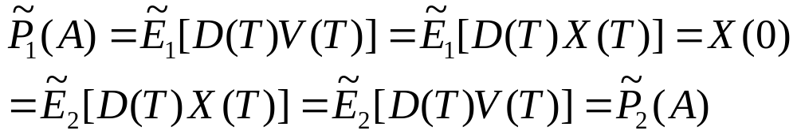
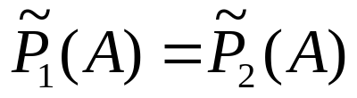
Theorem 5.4.9
(Second fundamental theorem of asset pricing)
Sketch of Proof (cont.)
  It follows that
  Since A is an arbitrary set in F and
  , these two risk-neutral measures are really the same.

Slide 25
Theorem 5.4.9
(Second fundamental theorem of asset pricing)
Sketch of Proof (cont.)
  For the converse, suppose there is only one risk-neutral measure.
  This means first of all that the filtration for the model is generated by the d-dimensional Brownian motion driving the assets.

Slide 26
Theorem 5.4.9
(Second fundamental theorem of asset pricing)
Sketch of Proof (cont.)
  If that were not the case (i.e., if there were other sources of uncertainty in the model besides the driving Brownian motions), then we could assign arbitrary probabilities to those sources of uncertainty without changing the distributions of the assets.
  This would permit us to create multiple risk-neutral measures.

Slide 27
Theorem 5.4.9
(Second fundamental theorem of asset pricing)
Sketch of Proof (cont.)
  Because the driving Brownian motions are the only sources of uncertainty, the only way multiple risk-neutral measures can arise is via multiple solutions to the market price of risk equations (5.4.18).
(5.4.18)

Slide 28
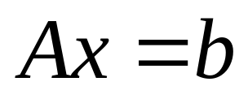
Theorem 5.4.9
(Second fundamental theorem of asset pricing)
Sketch of Proof (cont.)
  Hence, uniqueness of the risk-neutral measure implies that the market price of risk equations (5.4.18) have only one solution(Θ₁(t),…, Θ_{d}(t)).
  For fixed t and w, these equations are of the form
(5.4.30)

Slide 29
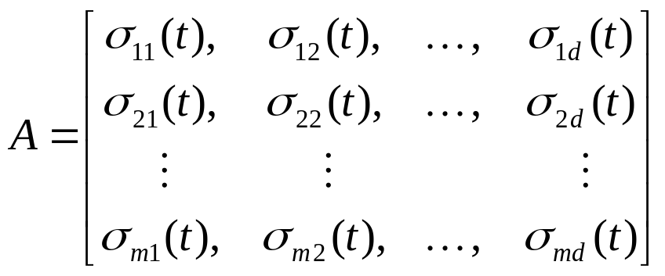
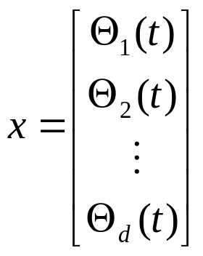
Theorem 5.4.9
(Second fundamental theorem of asset pricing)
Sketch of Proof (cont.)
  Where A is the m x d-dimensional matrix
  x is the d-dimensional column vector
(5.4.31)

Slide 30
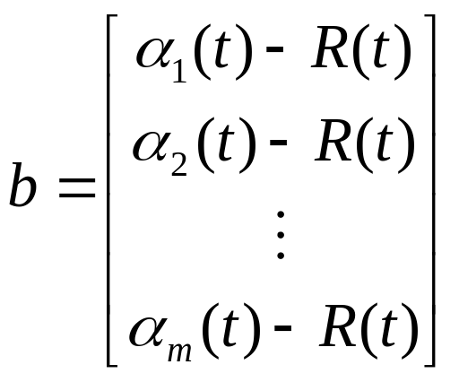
Theorem 5.4.9
(Second fundamental theorem of asset pricing)
Sketch of Proof (cont.)
  And b is the m-dimensional column vector
  Our assumption that there is only one risk-neutral measure means that the system of equations (5.4.30) has a unique solution x.

Slide 31
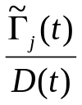
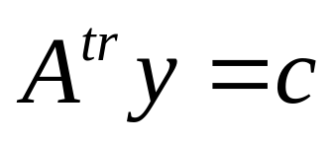
Theorem 5.4.9
(Second fundamental theorem of asset pricing)
Sketch of Proof (cont.)
  In other to be assures that every derivative security can be hedged, we must be able to solve the hedging equations (5.4.29) for ∆₁(t),…, ∆_{m}(t) no matter what values of appear on the left-hand side.
  For fixed t and w, the hedging equations are of the form
(5.4.32)

Slide 32
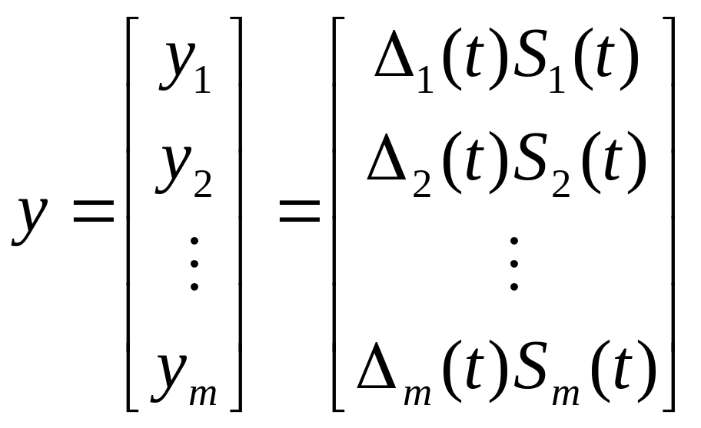
Theorem 5.4.9
(Second fundamental theorem of asset pricing)
Sketch of Proof (cont.)
  Where A^{tr} is the transpose of the matrix in (5.4.31), y is the m-dimensional vector

Slide 33
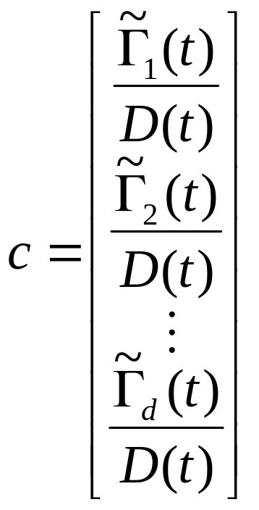
Theorem 5.4.9
(Second fundamental theorem of asset pricing)
Sketch of Proof (cont.)
  And c is the d-dimensional vector

Slide 34
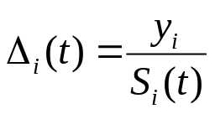
Theorem 5.4.9
(Second fundamental theorem of asset pricing)
Sketch of Proof (cont.)
  In order to be assured that the market is complete, there must be a solution y to the system of equations (5.4.32), no matter what vector c appears on the right-hand side.
  If there is always a solution y₁,…y_{m}, then there are portfolio processes satisfying the hedging equations (5.4.29), no matter what processes appear on the left-hand side of those equations.

Slide 35
Theorem 5.4.9
(Second fundamental theorem of asset pricing)
Sketch of Proof (cont.)
  We could then conclude that a short position in an arbitrary derivative security can be hedged.
  The uniqueness of the solution x to (5.4.30) implies the existence of a solution y to (5.4.32).
  We give a proof of this fact in Appendix C.
  Consequently, uniqueness of the risk-neutral measure implies that the market model is complete.

Slide 36
The risk-neutral probability measure is unique
➔ model is complete
x is unique
??
Ax=b
A^{tr}y=c
Any derivative security
Appendix C
Suppose unique probability measure

